Slide 1
Research Project Timeline
Task 1
6/20 - 12/26
Task 2
3/25 - 10/1
Task 3
3/14 - 6/12
Task 4
2/2 - 4/16
Task 5
1/5 - 5/23
Today
Q1
Q2
Q3
Q4
4/9/13
9/11/13
1/30/13
Milestone 2 Here
6/26/13
Milestone 4 Here
11/28/13
Milestone 1 Here
Milestone 3 Here
Milestone 5 Here

Slide 2
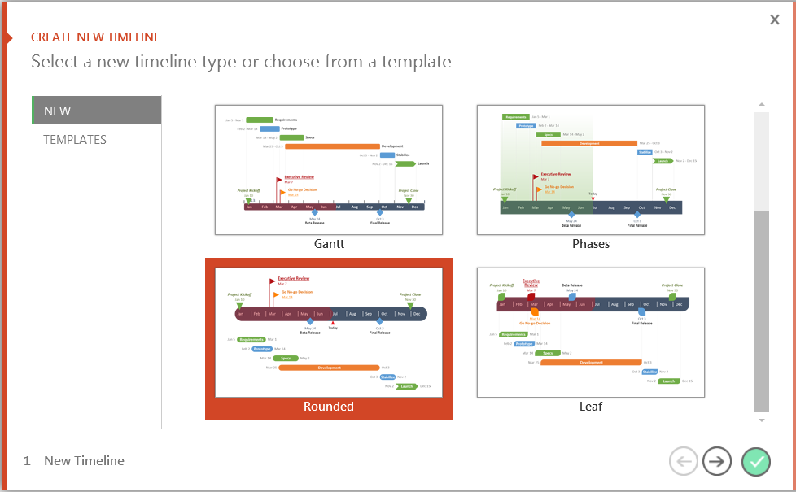
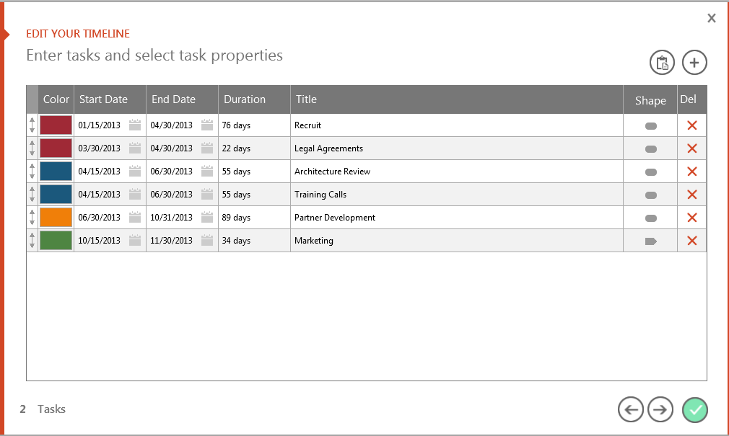
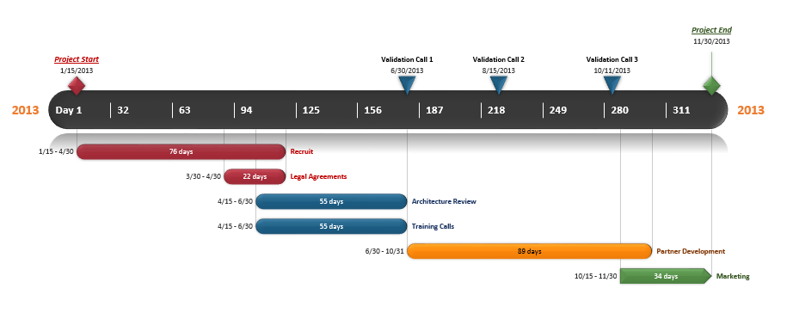
You can easily change this template or build new
timelines quickly, right inside PowerPoint!
Office Timeline is a FREE, award winning, timeline maker that's really easy to use.
Simple, easy-to-use wizards.
Professional, quick results.
Built directly into PowerPoint
1
Open your template or select a new one.
2
Choose dates, colors and shapes.
3
Click Finish to create your slide.

Slide 3

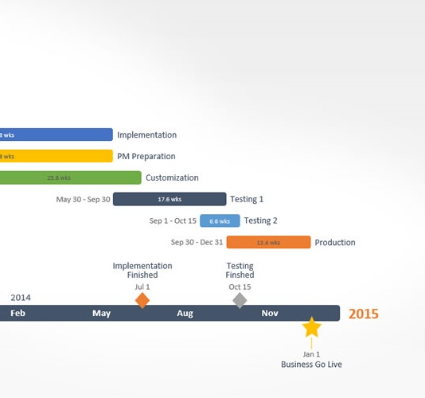
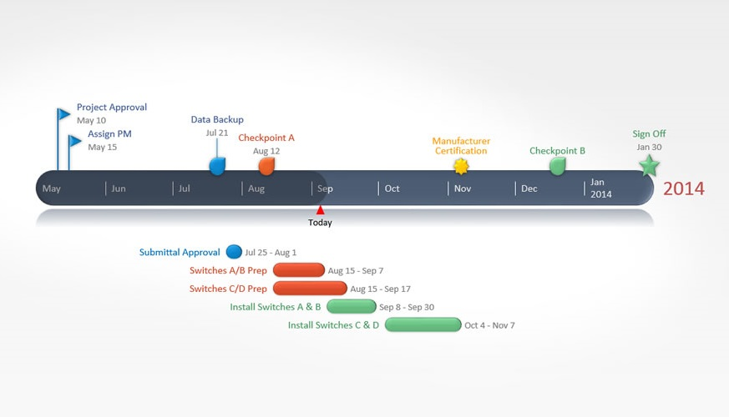
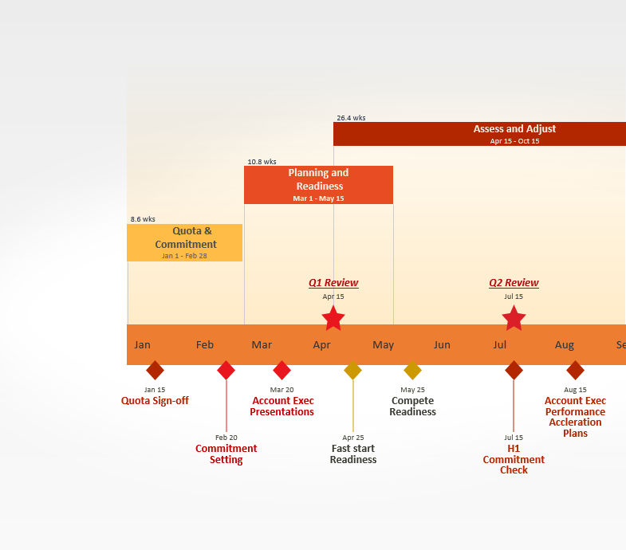

Get the Free Edition Now
FREE DOWNLOAD
Easily edit this template and create other
beautiful timelines quickly, right inside PowerPoint.
Copyright © 2012, Office Timeline, LLC. All rights reserved.
Download Now
www.GanttCharts.net

Slide 4
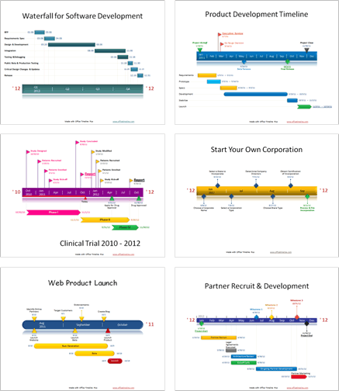
Stand out in a competitive market.
Impress customers, colleagues, and managers with professional timeline presentations built right from PowerPoint.
“
“I love this! I’ve been creating all these graphics manually for months and just wanted to smack myself upside the head when I saw this.”
“I can’t believe I’ve been using VISIO all these years! I've been missing out.”
“I've been building timelines for 22 years and this is the first tool I have found that quickly makes the kinds of slides my clients and management expect to see.
Copyright © 2012, Office Timeline, LLC. All rights reserved.

